Slide 1
Wired Local Area Network (LAN)
Topologies, requirements and problems

Slide 2
LOCAL AREA NETWORK (LAN)
Local area network is a communication network of computers and/or other network resources over a small geographical area. LAN networks usually span less than a few kilometers in diameter. It is usually used to connect resources in a room, floor or building or group of building.
LAN are mostly private owned networks, data is divided and transmitted in the form of packets and generated back by the receiving computer.

Slide 3
ETHERNET LAN (Wired connection)
Ethernet is a protocol that that controls the transmission of data in a LAN. Ethernet LAN uses Ethernet cable to connect the devices in a network, the network installation is wired and the switches and routers are configured using the network settings.
If multiple devices transmit data at once, the chances of signal collision is high. The computer which transmits would halt for a considerable time before retransferring the signals.

Slide 4
NETWORK TOPOLOGY
Network topology explains the mode of arrangement of the network components. It is defined as the pattern of interconnection between the nodes of a network.
The basic topologies in LAN are:
Mesh Topology
Star Topology
Bus Topology
Ring Topology
Hybrid Topology

Slide 5
Mesh Topology
In this topology, every device on the network is connected together, creating connections between all devices on the network through dedicated or concern point-to-point link.
The advantage here lies in when any connection between two devices fails, there is always an alternate path for the signal to the reach the destination.
problems
The wiring cost can be very high due to redundant cable connections
Troubleshooting a large mesh topology based network can be quite difficult

Slide 6
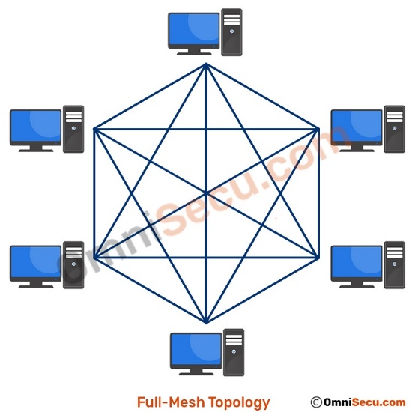
DIAGRAM OF A MESH TOPOLOGY

Slide 7
Star Topology
Here, the network nodes are connected directly to a central management device/component called the hub or network switch. This topology disallows direct communications between devices, all data is communicated via the central hub component.
problems
If the connecting network device fails (hub or network switch), nodes attached are disabled and cannot participate in computer network communication.
More expensive than the linear bus topology due to the cost of the connecting devices.
It requires many resources and periodic maintenance.

Slide 8
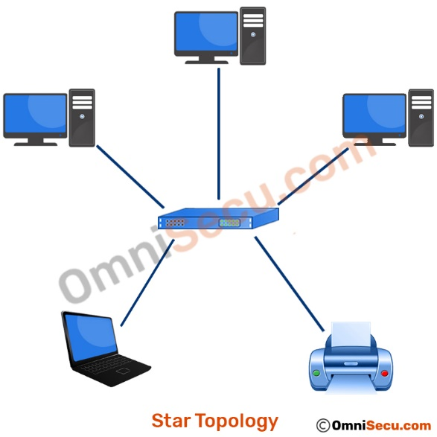
DIAGRAM OF STAR TOPOLOGY

Slide 9
Bus Topology
In Bus topology, the network components are connected to the main cable through drop lines with a terminator at each end. The terminator is used to absorb the signal when the signal gets to the end, preventing signal bounce.
problems
Entire network shuts down if there is a break in the main cable.
Terminators are required at both ends of the backbone cable.
Not meant to be used as a standalone solution

Slide 10
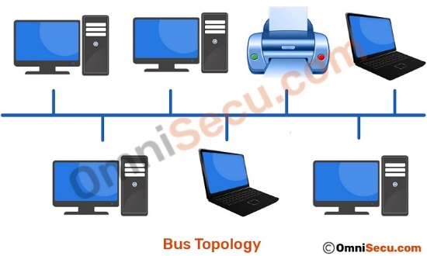
DIAGRAM OF BUS TOPOLOGY

Slide 11
Ring Topology
In Ring topology, all devices in the network are connected via a cable that loops in a logical ring or circle, the data circulate in a logical ring shape within the network.
Signals travel in one direction on a ring while they pass from one computer to the next. Each device in the ring topology can regenerate the data signal, so that the data signal can travel the required distance without signal quality deterioration.
problem
The disadvantage of ring topology is that the failure of links break the working of the entire network and the process gets to be stopped.

Slide 12
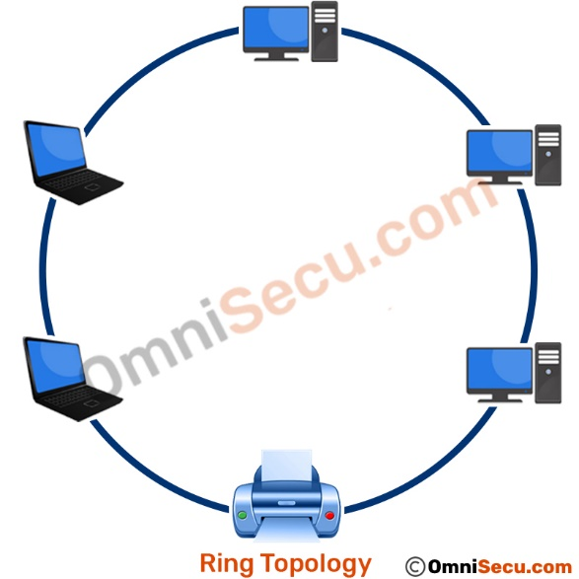
DIAGRAM OF A RING TOPOLOGY

Slide 13
Hybrid Topology
The combination of two topologies is called hybrid topology, it can be formed according to the requirement concerning the scalability and productivity. An example of a hybrid topology is a star-bus topology, star-ring topology, ring-mesh topology Etc.
problems
Fault detection is complex and installation is a tedious process.
There is a complex design and the deployment require expensive cost.

Slide 14
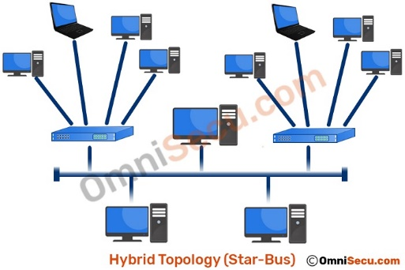
DIAGRAM OF HYBRID TOPOLOGY

